Slide 1
CS 4700: Foundations of Artificial Intelligence
Bart Selman
Problem Solving by Search
R&N: Chapter 3

Slide 2
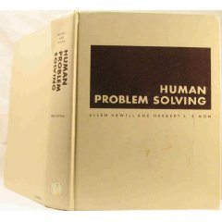
Introduction
Search is a central topic in AI.
Originated with Newell and Simon’s work on problem solving;
Human Problem Solving (1972).
Automated reasoning is a natural search task.
More recently: Given that almost all AI formalisms
(planning, learning, etc) are NP-Complete or worse,
some form of search is generally unavoidable
(i.e., no smarter algorithm available).

Slide 3
Outline
Problem-solving agents
Problem types
Problem formulation
Example problems
Basic search algorithms

Slide 4
Problem-solving agents
More details on “states” soon.
Problem solving agents are goal-directed agents:
Goal Formulation: Set of one or more (desirable) world states (e.g. checkmate in chess).
Problem formulation: What actions and states to consider given a goal and an initial state.
Search for solution: Given the problem, search for a solution --- a sequence of actions to achieve the goal starting from the initial state.
4. Execution of the solution
Note: Formulation feels somewhat “contrived,” but was meant
to model very general (human) problem solving process.

Slide 5
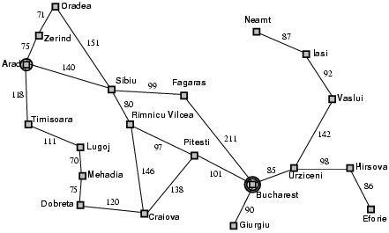
Example: Path Finding problem
Formulate goal:
be in Bucharest (Romania)
Formulate problem:
action: drive between pair of connected cities (direct road)
state: be in a city
(20 world states)
Find solution:
sequence of cities leading from start to goal state, e.g., Arad, Sibiu, Fagaras, Bucharest
Execution
drive from Arad to Bucharest according to the solution
Initial
State
Goal
State
Environment: fully observable (map),
deterministic, and the agent knows effects
of each action. Is this really the case?
Note: Map is somewhat of a “toy” example. Our real interest: Exponentially large spaces, with e.g. 10^100 or more states. Far beyond full search. Humans can often still handle those!
One of the mysteries of cognition.

Slide 6
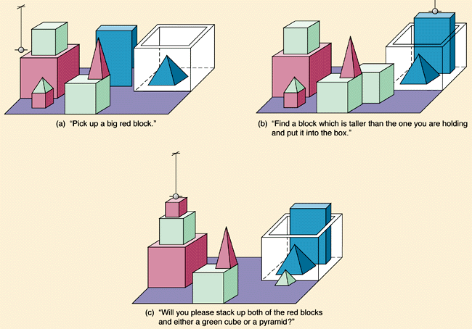
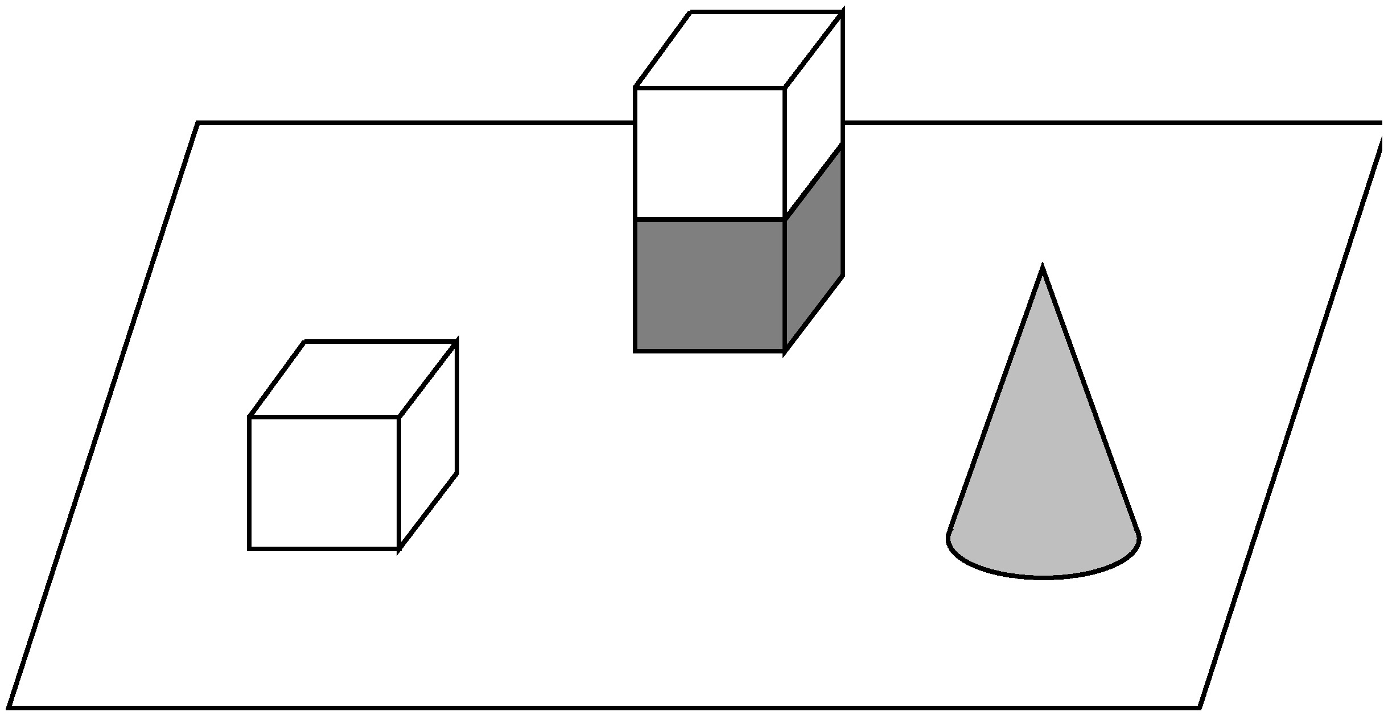
Micro-world: The Blocks World
gripper
How many
different possible
world states?
a) Tens?
b) Hundreds?
c) Thousands?
d) Millions?
e) Billions?
f) Trillions?
A
D
D
A
B
C
C
T
Initial State
Goal State

Slide 7
Size state space of blocks world example
n = 8 objects, k = 9 locations to build towers, one gripper. (One location in box.)
All objects distinguishable, order matter in towers. (Assume stackable
in any order.)
Blocks: Use r-combinations approach from Rosen (section 5.5; CS-2800).
- - - - - - - - - - - - - - - - consider 16 = (n + k – 1) “spots”
Select k – 1 = 8 “dividers” to create locations,
(16 choose 8) ways to do this, e.g.,
| | - - - | - | | - - - | | - | Allocate n = 8 objs to remaining spots, 8! ways, e.g.,
| | 4 1 8 | 5 | | 6 3 7 | | 2 | assigns 8 objects to the 9 locations
a b c d e f g h i based on dividers
So, total number of states (ignoring gripper): (16 choose 8) * 8! = 518,918,400
* 9 for location gripper: > 4.5 billion states even in this toy domain!
Search spaces grow exponentially with domain. Still need to search them, e.g., to
find a sequence of states (via gripper moves) leading to a desired goal state.

Slide 8
Problem types
1) Deterministic, fully observable
Agent knows exactly which state it will be in; solution is a sequence of actions.
2) Non-observable --- sensorless problem
Agent may have no idea where it is (no sensors); it reasons in terms of belief states; solution is a sequence actions (effects of actions certain).
3) Nondeterministic and/or partially observable: contingency problem
Actions uncertain, percepts provide new information about current state (adversarial problem if uncertainty comes from other agents).
Solution is a “strategy” to reach the goal.
4) Unknown state space and uncertain action effects: exploration problem
-- Solution is a “strategy” to reach the goal (end explore environment).
Increasing complexity

Slide 9
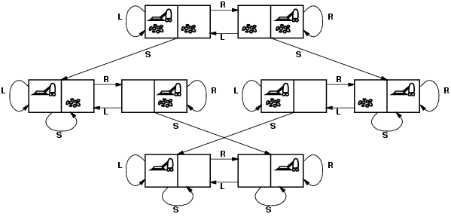
Example: Vacuum world state space graph
Start state
Goal
(reach one in
this set of states)
states?
actions?
goal test?
path cost?
The agent is in one of 8 possible world states.
Left, Right, Suck [simplified: left out No-op]
No dirt at all locations (i.e., in one of bottom two states).
1 per action
Minimum path from Start to Goal state:
Alternative, longer plan:
3 actions
4 actions
Note: path with thousands of steps before reaching goal also exist.

Slide 10
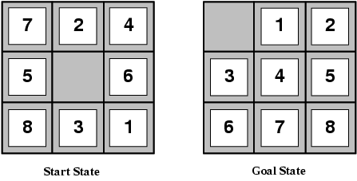
Example: The 8-puzzle “sliding tile puzzle”
Aside:
variations
on goal state.
eg empty square
bottom right or
in middle.
states? the boards, i.e., locations of tiles
actions? move blank left, right, up, down
goal test? goal state (given; tiles in order)
path cost? 1 per move
Note: finding optimal solution of n-puzzle family is NP-hard!
Also, from certain states you can’t reach the goal.
Total number of states 9! = 362,880 (more interesting space;
not all connected… only half can reach goal state)

Slide 11
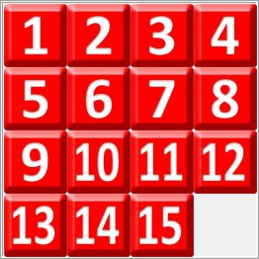
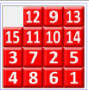
15-puzzle
Goal state
Search space:
16!/2 = 1.0461395 e+13,
about 10 trillion.
Too large to store in RAM
(>= 100 TB). A challenge to search
for a path from a given board to goal.
Korf:
Disk errors
become a
problem.
Longest minimum path: 80 moves. Just 17 boards, e.g,
Average minimum soln. length: 53.
People can find solns. But not necessarily
minimum length. See solve it! (Gives strategy.)
Korf, R., and Schultze, P. 2005. Large-scale parallel breadth-first search. In Proceedings of the 20th National Conference on Artificial Intelligence (AAAI-05).
See Fifteen Puzzle Optimal Solver. With effective search: opt. solutions in seconds!
Average: milliseconds.

Slide 12
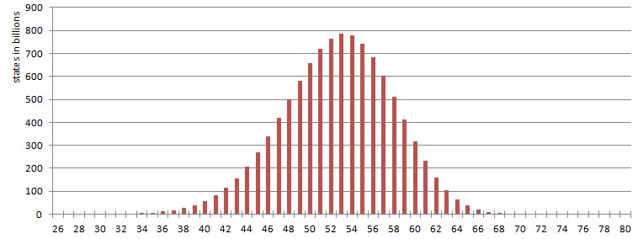
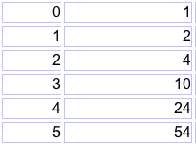
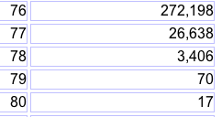
Where are the 10 trillion states?
# states in billions
minimum distance from goal state (# moves)
dist.
# states
dist.
# states
etc.

Slide 13
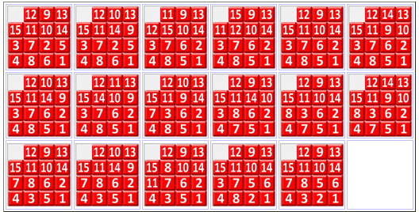
4
17 boards farthest away from goal state (80 moves)
1
13
<2,5,6>
?
<15,12,11>/
<9,10,14>
?
What is it about these 17 boards out of over 10 trillion?
?
Each require 80 moves to reach:
Intriguing similarities. Each number has its own few locations.
<3,7,8>
Interesting machine learning task:
Learn to recognize the hardest boards!
(Extremal Combinatorics, e.g. LeBras, Gomes, and Selman AAAI-12)

Slide 14

17 boards farthest away from goal state (80 moves)
Most regular extreme case:
Goal state
Each quadrant
reflected along
diagonal. “move
tiles furthest away”
Thanks to Jonathan GS

Slide 15
A few urls:
Play the eight puzzle on-line
Play the fifteen puzzle on-line
Let’s consider the search for a solution.

Slide 16
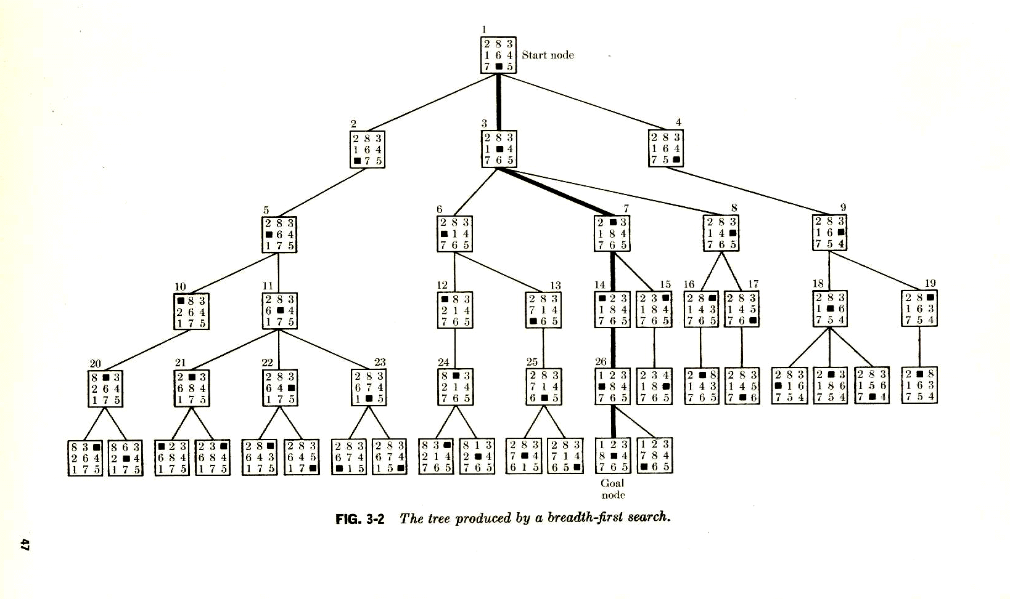
Searching for a solution
to the 8-puzzle.
Start state
Aside: in this tree, immediate
duplicates are removed.
Goal
A breadth-first search tree. (More detail soon.)
Branching factor 1, 2, or 3 (max). So, approx. 2 --- # nodes roughly doubles at each level. Number states of explored nodes grows exponentially with depth.

Slide 17
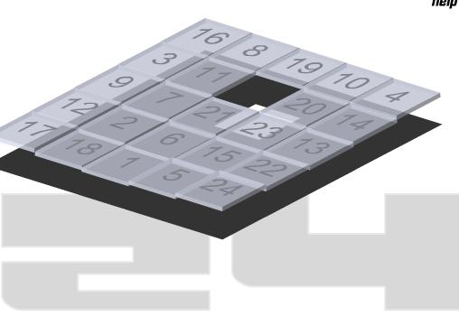
For 15-puzzle, hard initial states: 80 levels deep, requires
exploring approx. 2^80 ≈ 10^24 states.
If we block all duplicates, we get closer to 10 trillion (the number of
distinct states: still a lot!).
Really only barely feasible on compute cluster with lots of memory and
compute time. (Raw numbers for 24 puzzle, truly infeasible.)
Can we avoid generating all these boards? Do with much less search?
(Key: bring average branching factor down.)

Slide 18
Gedanken experiment: Assume that you knew for each state, the minimum
number of moves to the final goal state. (Table too big, but assume there is
some formula/algorithm based on the board pattern that gives this number
for each board and quickly.)
Using the minimum distance information, is there a clever way to find a
minimum length sequence of moves leading from the start state to the goal
state? How?

Slide 19
d = min dist. to goal
Hmm. How do I know?
d = 5
Start state
Note: at least one neighbor with d = 4.
d >= 5
Select
d = 4
d >= 4
d >= 4
Select
d = 3
d >= 3
d = 2
Select
Select
d = 1
Select
d = 0
d >= 1
Goal
A breadth-first search tree. (More detail soon.)
Branching factor approx. 2. So, with “distance oracle” we only need
to explore approx. 2 * (min. solution length).

Slide 20
For 15-puzzle, hard initial states: 80 levels deep, requires exploring
approx. 2^80 ≈ 10^24 states.
But, with distance oracle, we only need to explore roughly 80 * 2 = 160
states! (only linear in size of solution length)
We may not have the exact distance function (“perfect heuristics”), but
we can still “guide” the search using an approximate distance function.
This is the key idea behind “heuristic search” or “knowledge-based search.”
We use knowledge / heuristic information about the distance to the goal to
guide our search process. We can go from exponential to polynomial or even
linear complexity. More common: brings exponent down significantly.
E.g. from 2^L to 2^(L/100).
The measure we considered would be the “perfect” heuristic. Eliminates tree
search! Find the right “path” to goal state immediately.

Slide 21
Basic idea: State evaluation function can effectively guide search.
Also in multi-agent settings. (Chess: board eval.)
Reinforcement learning: Learn the state eval function.
Start state
Goal
A breadth-first search tree.
Perfect “heuristics,” eliminates search.
Approximate heuristics, significantly reduces search.
Best (provably) use of search heuristic info: A* search (soon).

Slide 22
State evaluation functions or “heuristics”
Provide guidance in terms of what action to take next.
General principle: Consider all neighboring states, reachable via some action. Then select the action that leads to the state with the highest utility (evaluation value). This is a fully greedy approach.
Because eval function is often only an estimate of the true state value, greedy search may not find the optimum path to the goal.
By adding some search with certain guarantees on the approximation, we can still get optimal behavior (A* search) (i.e. finding the optimal path to the solution). Overall result: generally exponentially less search required.

Slide 23
N-puzzle heuristics (“State evaluation function” wrt to goal to be reached):
Manhattan Distance: For each tile the number of grid units between its current location and its goal location are counted and the values for all tiles are summed up. (underestimate; too “loose”; not very powerful)
Felner, Ariel, Korf, Richard E., Hanan, Sarit, Additive Pattern Database Heuristics, Journal of Artificial Intelligence Research 22 (2004) 279-318. The 78 Pattern Database heuristic takes a lot of memory but solves a random instance of the 15-puzzle within a few milliseconds on average. An optimal solution for the 80 moves cases takes a few seconds each. So, thousands of nodes considered instead of many billions.
Note: many approx. heuristics (“conservative” / underestimates to goal) combined with search can still find optimal solutions.

Slide 24
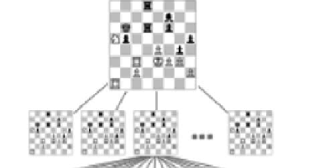
State evaluation function (or utility
value) is a very general and useful idea.
Example:
In chess, given a board, what would be the
perfect evaluation value that you would want to know?
(Assume the perspective of White player.)
A: f(board) → {+1, 0, -1}, with +1 for guaranteed win for White,
0 draw under perfect play, and
-1 loss under perfect play.
Perfect play: all powerful opponent.
Given f, how would you play then?
In practice, we only know (so far) of an approximation of f.
f(board) → [-1,+1] (interval from -1 to +1)
based on “values” of chess pieces, e.g., pawn 1 point, rook 5 points.
Informally, board value gives “probability (?) of winning.”

Slide 25
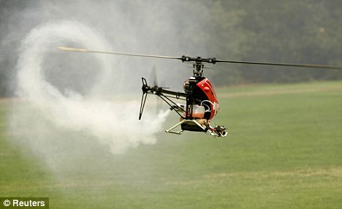
State evaluation function (or utility
value) is a very general and useful idea.
Examples:
TD-Gammon backgammon player. Neural net
was trained to find approximately optimal state (board)
evaluation values (range [-1,+1]). (Tesauro 1995)
“Robocopter” --- automated helicopter control;
trained state evaluation function.
State given by features, such as,
position, orientation, speed, and
rotors position and speed. Possible
actions change rotors speed and
position. Evaluation assigns value
in [-1,+1] to capture stability.
(Abbeel, Coates, and Ng 2008)

Slide 26
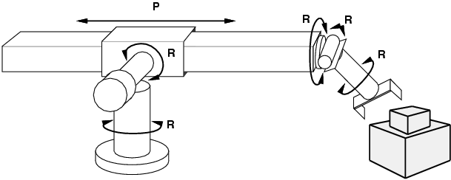
Example: Robotic assembly
states?: real-valued coordinates of robot joint angles
parts of the object to be assembled actions?: continuous motions of robot joints goal test?: complete assembly path cost?: time to execute

Slide 27
Other example search tasks
VLSI layout: positioning millions of components and connections on a chip to minimize area, circuit delays, etc.
Robot navigation / planning
Automatic assembly of complex objects
Protein design: sequence of amino acids that will fold into the 3-dimensional protein with the right properties.
Literally thousands of combinatorial search / reasoning / parsing /
matching problems can be formulated as search problems in exponential
size state spaces.

Slide 28
Search Techniques

Slide 29
Searching for a (shortest / least cost) path to goal state(s).
Search through the state space.
We will consider search techniques that use an
explicit search tree that is generated by the
initial state + successor function.
initialize (initial node)
Loop
choose a node for expansion according to strategy
goal node? → done
expand node with successor function

Slide 30
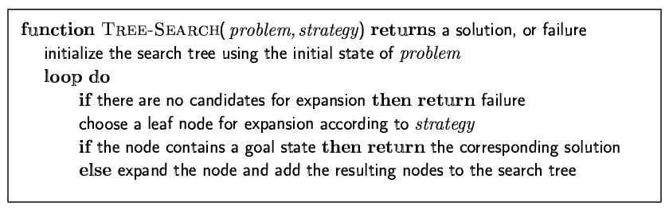
Tree-search algorithms
Basic idea:
simulated exploration of state space by generating successors of already-explored states (a.k.a. ~ expanding states)
Fig. 3.7 R&N, p. 77
Note: 1) Here we only check a node for possibly being a goal state, after we select the node for expansion.
2) A “node” is a data structure containing state + additional info (parent
node, etc.

Slide 31
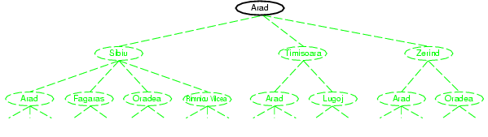
Tree search example
Node selected
for expansion.

Slide 32
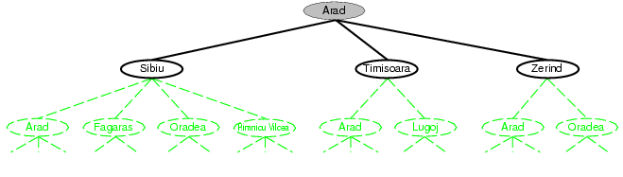
Nodes added to tree.

Slide 33
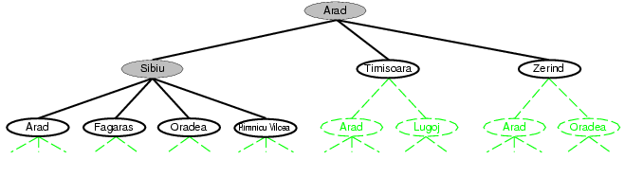
Selected for expansion.
Added to tree.
Note: Arad added (again) to tree!
(reachable from Sibiu)
Not necessarily a problem, but
in Graph-Search, we will avoid
this by maintaining an
“explored” list.

Slide 34
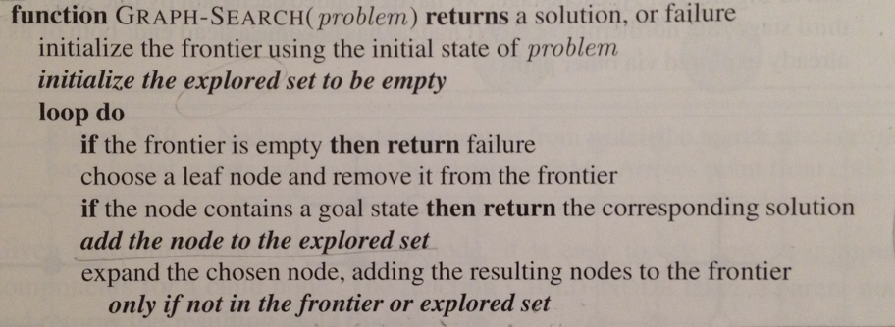
Graph-search
Fig. 3.7 R&N, p. 77. See also exercise 3.13.
Note:
1) Uses “explored” set to avoid visiting already explored states.
2) Uses “frontier” set to store states that remain to be explored and expanded.
3) However, with eg uniform cost search, we need to make a special check when
node (i.e. state) is on frontier. Details later.

Slide 35
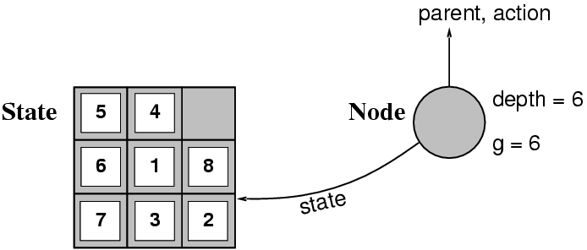
Implementation: states vs. nodes
A state is a --- representation of --- a physical configuration.
A node is a data structure constituting part of a search tree includes state, tree parent node, action (applied to parent), path cost (initial state to node) g(x), depth
The Expand function creates new nodes, filling in the various fields and using the SuccessorFn of the problem to create the corresponding states.
Fringe is the collection of nodes that have been generated but not (yet)
expanded. Each node of the fringe is a leaf node.

Slide 36
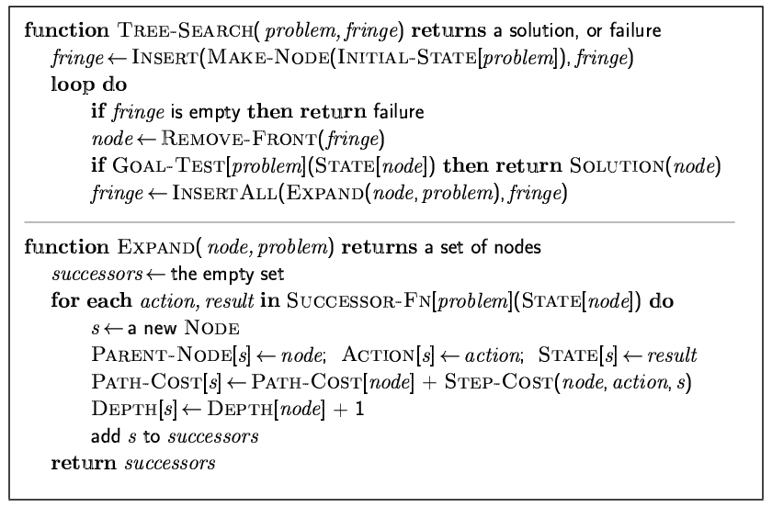
Implementation: general tree search

Slide 37
Search strategies
A search strategy is defined by picking the order of node expansion.
Strategies are evaluated along the following dimensions:
completeness: does it always find a solution if one exists?
time complexity: number of nodes generated
space complexity: maximum number of nodes in memory
optimality: does it always find a least-cost solution?
Time and space complexity are measured in terms of
b: maximum branching factor of the search tree
d: depth of the least-cost solution
m: maximum depth of the state space (may be ∞)

Slide 38
Uninformed search strategies
Uninformed (blind) search strategies use only the information available in the problem definition:
Breadth-first search
Uniform-cost search
Depth-first search
Depth-limited search
Iterative deepening search
Bidirectional search
Key issue: type of queue used for the fringe of the search tree
(collection of tree nodes that have been generated but not yet
expanded)

Slide 39
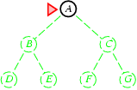
Breadth-first search
Expand shallowest unexpanded node.
Implementation:
fringe is a FIFO queue, i.e., new nodes go at end
(First In First Out queue.)
Fringe queue: <A>
Select A from
queue and expand.
Gives
<B, C>

Slide 40
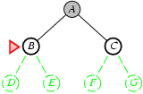
Queue: <B, C>
Select B from
front, and expand.
Put children at the
end.
Gives
<C, D, E>

Slide 41
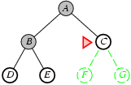
Fringe queue: <C, D, E>

Slide 42
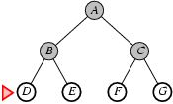
Fringe queue: <D, E, F, G>
Assuming no further children, queue becomes
<E, F, G>, <F, G>, <G>, <>. Each time node checked
for goal state.

Slide 43
Properties of breadth-first search
Note: check for
goal only when
node is expanded.
Complete? Yes (if b is finite)
Time? 1+b+b²+b³+… +b^{d} + b(b^{d}-1) = O(b^{d+1})
Space? O(b^{d+1}) (keeps every node in memory;
needed also to reconstruct soln. path)
Optimal soln. found?
Yes (if all step costs are identical)
Space is the bigger problem (more than time)
b: maximum branching factor of the search tree
d: depth of the least-cost solution

Slide 44
Uniform-cost search
Expand least-cost (of path to) unexpanded node
(e.g. useful for finding shortest path on map) Implementation:
fringe = queue ordered by path cost
Complete? Yes, if step cost ≥ ε (>0) Time? # of nodes with g ≤ cost of optimal solution (C*), O(b^{(1+⎣C*/ ε⎦})
Space? # of nodes with g ≤ cost of optimal solution,
O(b^{(1+⎣C*/ ε⎦})
Optimal? Yes – nodes expanded in increasing order of g(n)
Note: Some subtleties (e.g. checking for goal state).
See p 84 R&N. Also, next slide.
g – cost of reaching a node

Slide 45
Uniform-cost search
Two subtleties: (bottom p. 83 Norvig)
Do goal state test, only when a node is selected for expansion.
(Reason: Bucharest may occur on frontier with a longer than
optimal path. It won’t be selected for expansion yet. Other nodes
will be expanded first, leading us to uncover a shorter path to
Bucharest. See also point 2).
2) Graph-search alg. says “don’t add child node to frontier if already on
explored list or already on frontier.” BUT, child may give a shorter path
to a state already on frontier. Then, we need to modify the existing
node on frontier with the shorter path. See fig. 3.14 (else-if part).

Slide 46
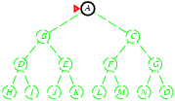
Depth-first search
“Expand deepest unexpanded node”
Implementation:
fringe = LIFO queue, i.e., put successors at front (“push on stack”)
Last In First Out
Fringe stack:
A
Expanding A,
gives stack:
B
C
So, B next.

Slide 47
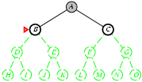
Expanding B, gives stack:
D
E
C
So, D next.

Slide 48
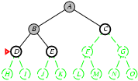
Expanding D, gives stack:
H
I
E
C
So, H next.
etc.

Slide 49
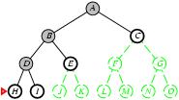

Slide 50
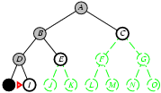

Slide 51
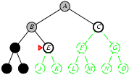

Slide 52
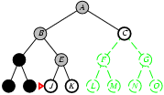

Slide 53
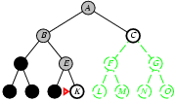

Slide 54
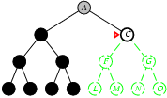

Slide 55
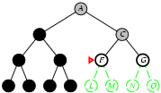

Slide 56
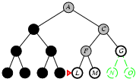

Slide 57
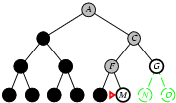

Slide 58
Properties of depth-first search
Complete?
Time? O(b^{m}): bad if m is much larger than d
but if solutions are dense, may be much faster than breadth-first
Space?
Guarantee that
opt. soln. is found?
No: fails in infinite-depth spaces, spaces with loops
Modify to avoid repeated states along path
→ complete in finite spaces
Note: Can also reconstruct soln. path from single stored branch.
O(bm), i.e., linear space!
b: max. branching factor of the search tree
d: depth of the shallowest (least-cost) soln.
m: maximum depth of state space
No
Note: In “backtrack search” only one successor is generated
→ only O(m) memory is needed; also successor is modification of
the current state, but we have to be able to undo each modification.
More when we talk about Constraint Satisfaction Problems (CSP).

Slide 59
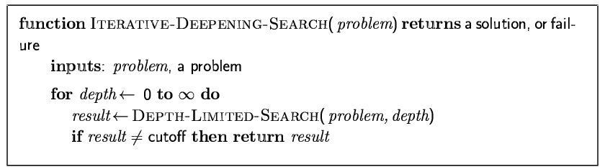
Iterative deepening search
[here]

Slide 60
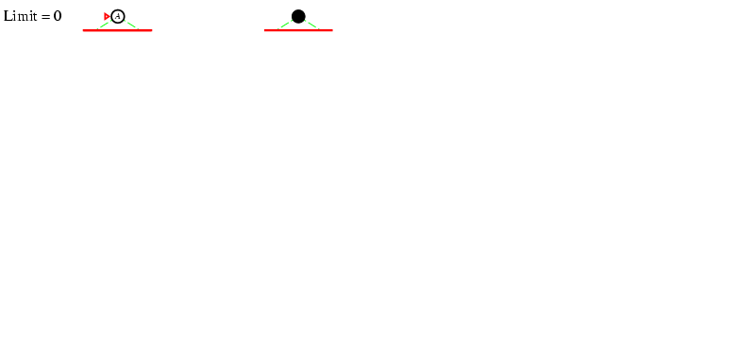
Iterative deepening search l =0

Slide 61
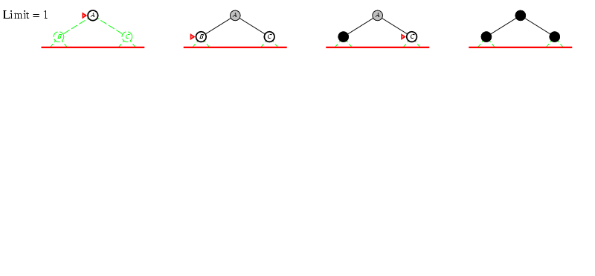
Iterative deepening search l =1

Slide 62
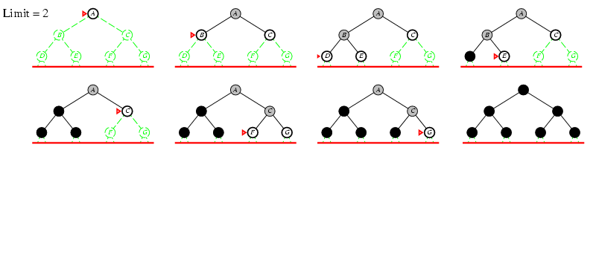
Iterative deepening search l =2

Slide 63
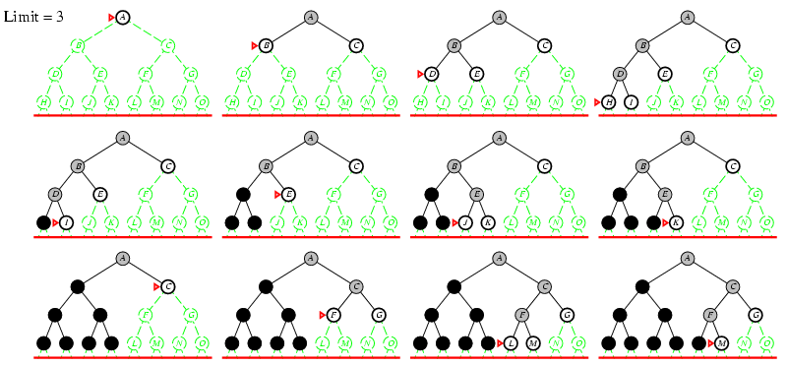
Iterative deepening search l =3

Slide 64
Why would one do that?
Combine good memory requirements of depth-first with
the completeness of breadth-first when branching factor is
finite and is optimal when the path cost is a non-decreasing
function of the depth of the node.
Idea was a breakthrough in game playing. All game
tree search uses iterative deepening nowadays. What’s
the added advantage in games?
“Anytime” nature.

Slide 65
Iterative deepening search
Number of nodes generated in an iterative deepening search to depth
d with branching factor b:
N_{IDS} = d b¹ + (d-1)b² + … + 3b^{d-2} +2b^{d-1} + 1b^{d}
Nodes generated in a breadth-first search with branching factor b:
N_{BFS} = b¹ + b² + … + b^{d-2} + b^{d-1} + b^{d}
For b = 10, d = 5,
N_{BFS}= 10 + 100 + 1,000 + 10,000 + 100,000 = 111,110
N_{IDS} = 50 + 400 + 3,000 + 20,000 + 100,000 = 123,456
Looks quite wasteful, is it?
☺
Iterative deepening is the preferred uninformed search method
when there is a large search space and the depth of the solution
is not known.

Slide 66
Properties of iterative deepening search
Complete? Yes (b finite)
Time? d b¹ + (d-1)b² + … + b^{d} = O(b^{d})
Space? O(bd)
Optimal? Yes, if step costs identical

Slide 67
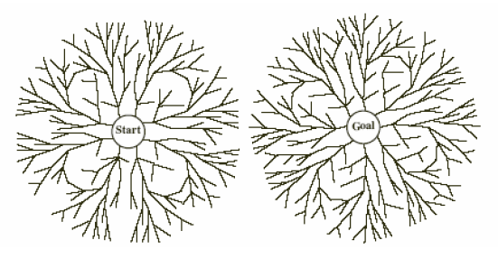
Bidirectional Search
Simultaneously:
Search forward from start
Search backward from the goal
Stop when the two searches meet.
If branching factor = b in each direction,
with solution at depth d
➔ only O(2 b^{d/2})= O(2 b^{d/2})
Checking a node for membership in the other search tree can be done in constant time (hash table)
Key limitations:
Space O(b^{d/2})
Also, how to search backwards can be an issue (e.g., in Chess)? What’s tricky?
Problem: lots of states satisfy the goal; don’t know which one is relevant.
Aside: The predecessor of a node should be easily computable (i.e., actions are easily reversible).

Slide 68
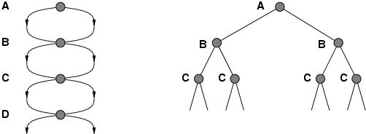
Repeated states
Failure to detect repeated states can turn
linear problem into an exponential one!
Don’t return to parent node
Don’t generate successor = node’s parent
Don’t allow cycles
Don’t revisit state
Keep every visited state in memory! O(b^{d}) (can be expensive)
Problems in which actions are reversible (e.g., routing problems or sliding-blocks puzzle). Also, in eg Chess; uses hash tables to check
for repeated states. Huge tables 100M+ size but very useful.
See Tree-Search vs. Graph-Search in Fig. 3.7 R&N. But need to
be careful to maintain (path) optimality and completeness.

Slide 69
Summary: General, uninformed search
Original search ideas in AI where inspired by studies of human problem solving in, eg, puzzles, math, and games, but a great many AI tasks now require some form of search (e.g. find optimal agent strategy; active learning; constraint reasoning; NP-complete problems require search).
Problem formulation usually requires abstracting away real-world details to define a state space that can feasibly be explored.
Variety of uninformed search strategies
Iterative deepening search uses only linear space and not much more time than other uninformed algorithms.
Avoid repeating states / cycles.

